Slide 1

Noida Institute of Engineering & Technology
Department of CSE (AI)
Session (2024-25)
Programming for Data Analysis
Project (ACSAI0617)
Presentation on
“Traffic Sign Recognition System Using CNN and Keras”
Submitted To: Ms. Garima Jain Asst. Prof. & Dy. Head, CSBS |  | Group Member: VISHAL VERMA (2201331520211) TARANG VERMA (2201331520194) SHIVAM SINGH (2201331520167)

Slide 2

Presentation Outline
Introduction
Literature Review
Research Gap
How to overcome Research Gap
Objectives of the Research work
Methodology
Result
Conclusion
References

Slide 3
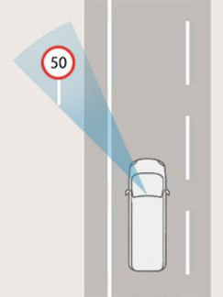
Introduction
Traffic Sign Recognition (TSR) System Overview
TSR is vital for autonomous vehicles and driver assistance in modern Intelligent Transportation Systems (ITS).
Traditional methods struggle with real-world conditions (e.g., lighting, occlusion).
Our CNN-based approach (Keras + TensorFlow) ensures accurate, real-time detection and classification.
Key Highlights:
Real-time TSR using Convolutional Neural Networks.
Trained on diverse datasets (Germany, India).
Optimized for edge devices (Raspberry Pi, Jetson Nano).
Real-time webcam integration via OpenCV.

Slide 4
Literature Review
The literature in TSR highlights an evolution from traditional machine learning methods to deep learning models:
Traditional Approaches:
Used techniques like color thresholding, shape matching, and SVM.
Required handcrafted features and failed under noise, blur, or poor lighting.
Modern Approaches (Deep Learning):
Cireşan et al. (2012): Used multiple CNN models together and got very high accuracy on the German traffic sign dataset.
Sermanet & LeCun (2011): Built a CNN that learns from raw image pixels and handled changes in image size, light, and position well.
Song et al. (2019): Created a small CNN that works on low-power devices which is fast and accurate —good for real-time use in cars.
Observations:
CNNs outperform traditional methods in accuracy and adaptability.
Data augmentation and dropout improve generalization.
Real-time performance and domain transferability still remain underexplored.
This study addresses those gaps with a generalizable and efficient model suited for real-world deployment.

Slide 5
Research Gap
Despite advancements, several challenges persist in Traffic Sign Recognition:
Key Gaps Identified:
⚠️ Lack of cross-domain adaptability: Most models perform well on a single dataset but fail on others.
⚠️ High model complexity: Deep architectures like AlexNet are unsuitable for embedded platforms.
⚠️ Poor real-time performance: Inference lag in traditional systems limits real-world usability.
⚠️ Environmental fragility: Performance drops under lighting variations, motion blur, and partial occlusion.
Implication: These gaps hinder TSR systems from being practically deployed in vehicles, especially in diverse environments like India, Saudi Arabia, or North Africa.
Our project aims to overcome these limitations by designing a compact, fast, and robust model with multi-dataset training and real-time integration.

Slide 6
How to overcome Research Gap
To overcome the challenges identified, the following strategies were adopted:
✔ Multi-Region Training
Datasets from Germany (GTSRB), India, Saudi Arabia, and Tunisia were used.
Promotes generalization across different languages, sign shapes, and environments.
✔ Compact CNN Architecture
Designed a custom CNN with only ~1.8 million parameters.
Reduces memory footprint without sacrificing accuracy.
✔ Real-Time Optimization
Integrated model with OpenCV for live webcam input.
Achieves 14–18 FPS on devices like Raspberry Pi 4.
✔ Data Augmentation
Rotation, brightness shift, zooming, and Gaussian noise applied.
Helps simulate real-world conditions like fog, night driving, and occlusion.
✔ Edge Deployment
Ensured model works smoothly on low-cost hardware like Jetson Nano.
Demonstrates real-world readiness and scalability.
These strategies create a practical, fast, and accurate TSR solution tailored for embedded ADAS systems.

Slide 7
Objective of the Research work
The main goal of this research is to develop a high-performance TSR system using CNNs in Keras that is suitable for real-time deployment on low-resource devices.
Specific Objectives:
Collect and preprocess a diverse traffic sign dataset across regions.
Design a lightweight CNN with minimal parameters and high classification accuracy.
Train the model using data augmentation and validation strategies.
Integrate the model with webcam input for real-time testing via OpenCV.
Optimize inference speed for embedded devices (14–18 FPS on Raspberry Pi/Jetson).
Evaluate the model on accuracy, F1-score, confusion matrix, and FPS.
Expected Outcomes:
A generalizable, real-time TSR system.
Deployable model that balances speed, accuracy, and memory efficiency.
Foundation for future integration in intelligent vehicles and ADAS.

Slide 8
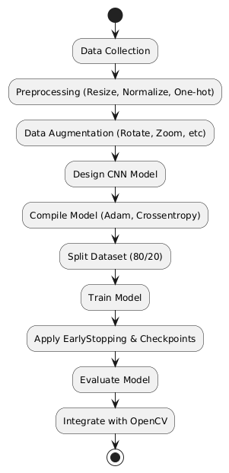
Methodology
Data Preparation
Datasets: GTSRB, Indian, SA-TRS, Tunisian
Preprocessing: Resize (64×64), Normalize, One-hot Encode
Augmentation: Rotate, Zoom, Brightness, Noise, Flip
CNN Model
Layers: 3×Conv → MaxPooling → Dropout → Dense → Softmax
~1.8M parameters, optimized for edge devices
Loss: Categorical Crossentropy, Optimizer: Adam
Training
Train/Validation Split: 80/20
Techniques: EarlyStopping, ModelCheckpoint
Deployment
Real-time webcam detection (OpenCV)
Tested on Raspberry Pi 4 & Jetson Nano

Slide 9
Result
The proposed CNN model was thoroughly evaluated on both static test sets and real-time scenarios.
Performance Highlights:
✅ Test Accuracy: 97.3% across multi-domain datasets.
✅ F1-Score: 0.972 – strong balance between precision and recall.
✅ Real-Time FPS: 14–18 FPS on Raspberry Pi and Jetson Nano.
✅ Inference Time: <70 ms/frame on embedded hardware.
Confusion Matrix Observations:
Most classes >90% precision.
Minor confusion between similar-shaped signs like speed limits and warnings.
The model achieved its objective of being fast, accurate, and real-time deployable.

Slide 10
Conclusion
✅ Achievements:
97.3% accuracy on multi-region datasets
Real-time performance (14–18 FPS on edge devices)
Robust under lighting, occlusion, and motion
Lightweight CNN (~1.8M parameters), ideal for ADAS
🚀 Future Directions:
Integrate object detection (YOLO/SSD)
Add OCR for text/multilingual signs
Combine with GPS/LiDAR for sensor fusion
Enable continuous learning for adaptability

Slide 11
References
D. C. Cireşan et al., “Multi-column DNNs for traffic sign classification,” Neural Networks, 2012.
P. Sermanet & Y. LeCun, “Traffic sign recognition with convolutional networks,” IJCNN, 2011.
S. Song et al., “Efficient CNN for small traffic sign detection,” Journal of Systems Architecture, 2019.
D. A. Alghmghama et al., “Autonomous Traffic Sign Detection Using Deep CNN,” Procedia CS, 2019.
R. K. Megalingam et al., “Indian Traffic Sign Recognition Using Deep Learning,” IJTST, 2023.
GTSRB Dataset: benchmark.ini.rub.de
OpenCV Documentation: docs.opencv.org

Slide 12

Noida institute of Engineering & Technology

